Slide 1
Clustering

Slide 2
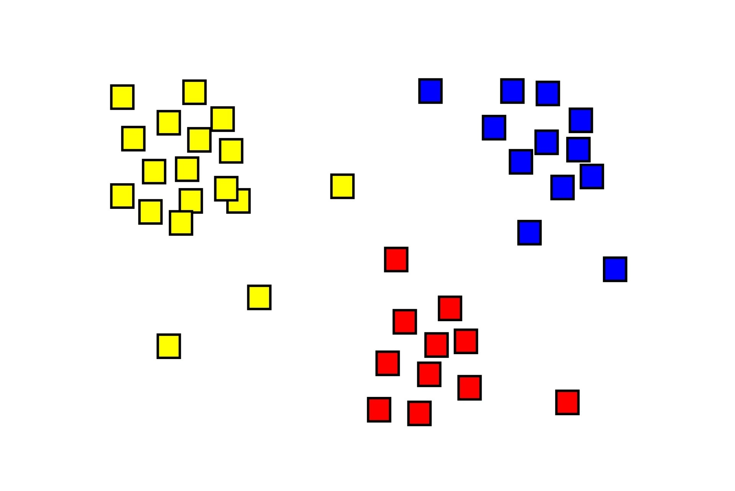
CLUSTERING
Clustering could be “the process of organizing objects into groups whose members are similar in some way”.
A cluster is therefore a collection of objects which are “similar” between them and are “dissimilar” to the objects belonging to other clusters
Need for clustering
To find structure in unlabeled data.
To discover groups, pattern of objects
Explorative analysis
Clustered Data Points
Notes:
Clustering : https://en.wikipedia.org/wiki/Cluster_analysis

Slide 3
Clusters TAXONOMY
Distance
K-Means(Euclidean)
Hierarchical(Pair-wise distance)
Distribution
Expectation Maximization(Likelihood)
Connectivity
DBScan(Neighborhood distance)
Spectral(Nearest Neighbor)
Neural Model
SOM
Conditional Random Field(Probability)

Slide 4
K-MEANS
k-means clustering, is an iterative, data-partitioning
algorithm that assigns n observations to exactly
one of k clusters defined by centroids.
here k is chosen before the algorithm starts
e.g., Euclidean distance
Notes:
https://en.wikipedia.org/wiki/K-means_clustering

Slide 5
Algorithm
Given the cluster number K:
The K-means algorithm is carried out in three steps after initialization:
Initialization: set seed points (randomly)
Assign each object to the cluster of the nearest seed point measured with a specific distance metric(typically Euclidean distance)
Compute new seed points as the centroids of the clusters of the current partition (the centroid is the centre, i.e., mean point, of the cluster)
Go back to Step 1), stop when no more new assignment (i.e., membership in each cluster no longer changes)

Slide 6
ADVANTAGES and DISADVANATAGES
Advantages
If variables are huge, then K-Means is computationally faster if we keep k small
K-Means produce tighter clusters than hierarchical clustering, especially if the clusters are globular
Disadvantages
Sensitive to initial condition(k, no. of iterations)
Clusters are circular in shape since distance is measurement
Outliers pull centroid away from the real one
K must be determined before hand

Slide 7
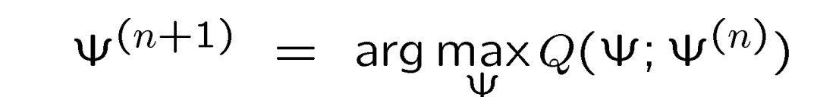
EXPECTATION MAXIMISATION
It is an iterative method to find maximum likelihood
estimates of parameters where the model depends on
unobserved latent variables
The EM iteration alternates between performing an
Expectation (E) :
It creates a function for the expectation of the
log-likelihood evaluated using the current estimate for
the parameters and
Maximization (M):
It computes parameters maximizing the expected
log-likelihood found on the E step. These parameter-
estimates are then used to determine the distribution of
the latent variables in the next E step.
EM Clustering
Notes:
https://en.wikipedia.org/wiki/Expectation%E2%80%93maximization_algorithm

Slide 8
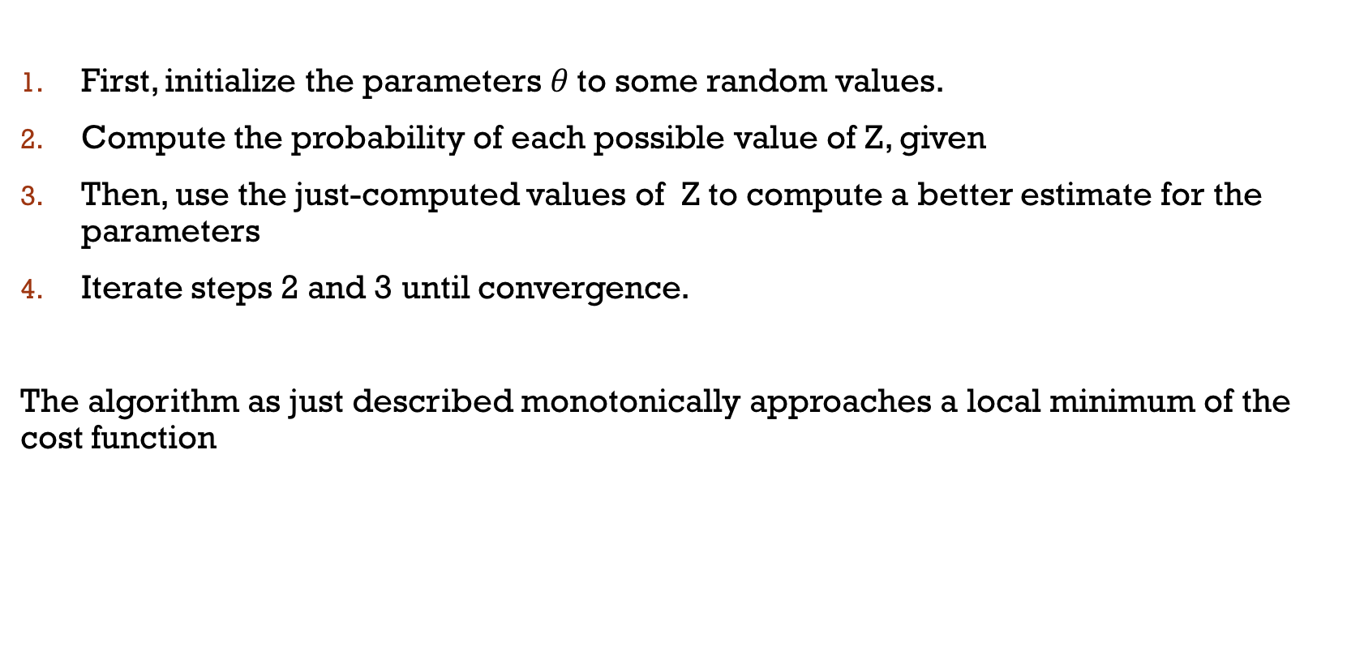


ALGORITHM
First, initialize the parameters$θ$ to some random values.
Compute the probability of each possible value of Z, given
Then, use the just-computed values of Z to compute a better estimate for the parameters
Iterate steps 2 and 3 until convergence.
The algorithm as just described monotonically approaches a local minimum of the cost function
$$θ$$
$$θ$$
Notes:
https://math.stackexchange.com/questions/25111/how-does-expectation-maximization-work

Slide 9
ADVANTAGEs AND DISADVANTAGEs
Advantages
Likelihood is guaranteed to increase for each iteration
Is a derivative-free optimizer
Is fast if analytical expressions for the M-step are available
Parameter constraints are often dealt with implicitly
Disadvantages
Slow convergence
Requires both forward and backward probabilities

Slide 10
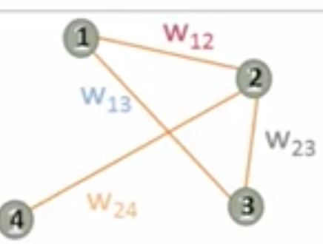
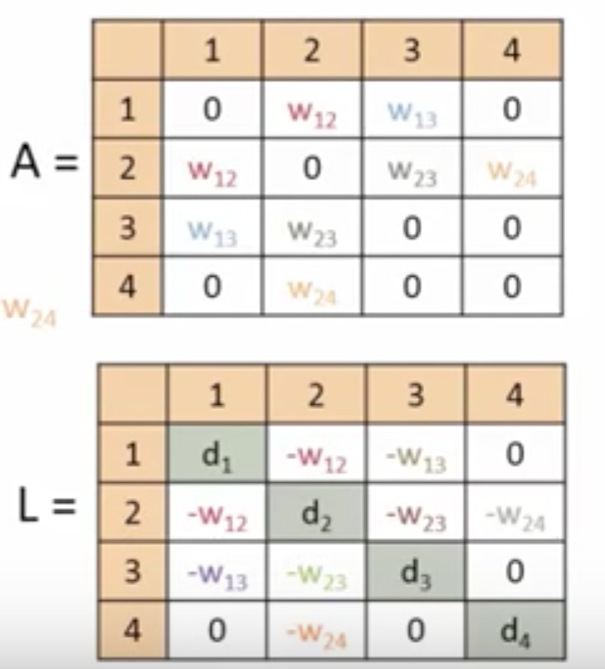
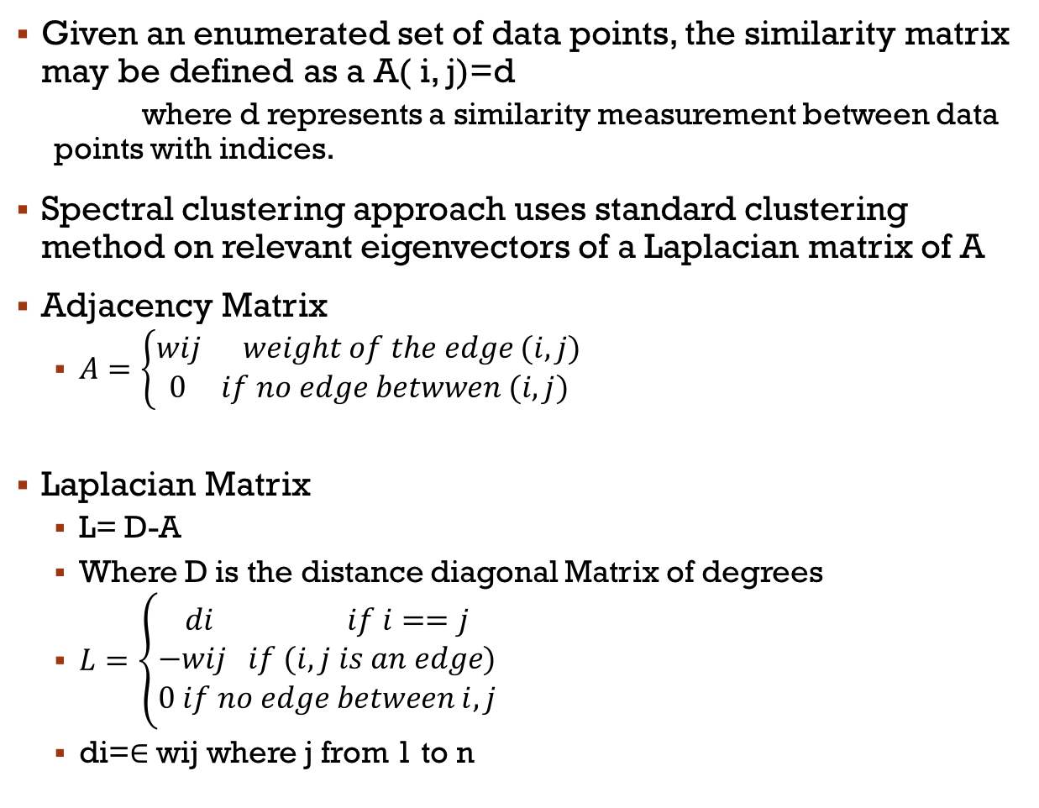
SPECTRAL CLUSTERING
Given an enumerated set of data points, the similarity matrix may be defined as a A( i, j)=d
where d represents a similarity measurement between data points with indices.
Spectral clustering approach uses standard clustering method on relevant eigenvectors of a Laplacian matrix of A
Adjacency Matrix
$A=\left\{\begin{aligned}wij weight of the edge (i,j) \\ 0 if no edge betwwen (i,j)\end{aligned}\right.$
Laplacian Matrix
L= D-A
Where D is the distance diagonal Matrix of degrees
$L=\left\{\begin{aligned}di if i==j \\ −wij if (i,j is an edge) \\ 0 if no edge between i,j\end{aligned}\right.$
di=$∈$ wij where j from 1 to n
Notes:
https://en.wikipedia.org/wiki/Spectral_clustering
https://arxiv.org/pdf/0711.0189.pdf

Slide 11
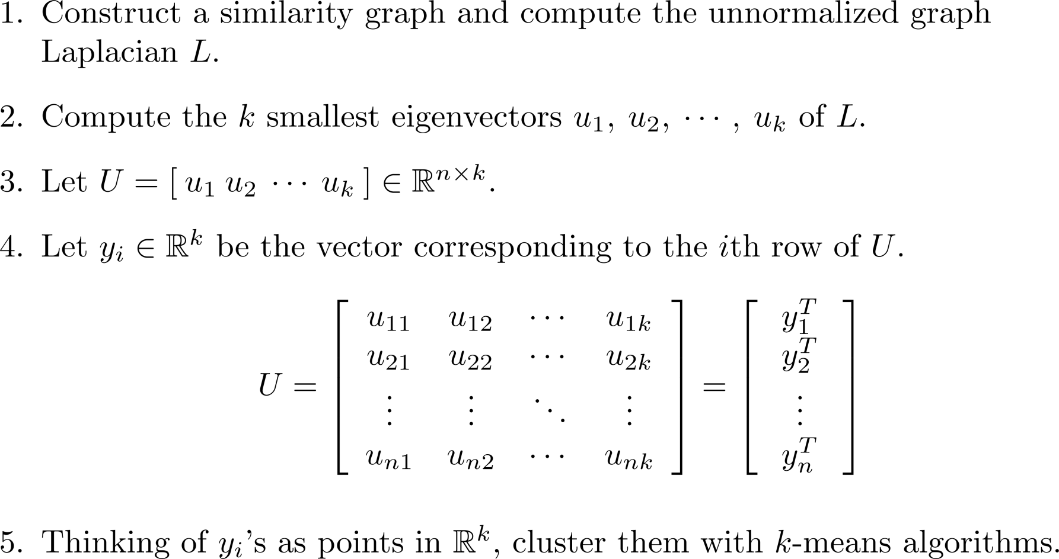
ALGORITHM

Slide 12
Advantages AND DISADVANTAGES
Advantages:
Makes no assumption on shape of clusters(can be a spiral)
No iterative approach

Slide 13

DENSITY BASED CLUSTERING
Given a set of points in some space,
It groups together points that are closely packed together (points with many nearby neighbors)
Marks points as outliers points that lie alone in low-density regions (whose nearest neighbors are too far away)
Here the cluster is defined as a connected dense component which can grow in any direction that density leads
Notes:
https://en.wikipedia.org/wiki/DBSCAN

Slide 14
DBSCAN ALGORITHM
The DBSCAN algorithm can be abstracted into the following steps:
Find the ε (eps) neighbors of every point, and identify the core points with more than minPts neighbors.
Find the connected components of core points on the neighbor graph, ignoring all non-core points.
Assign each non-core point to a nearby clusters at at most distance ε (eps), otherwise assign it to noise.

Slide 15
ADVANTAGES AND DISADVANTAGES
Advantages
It does not require one to specify the number of clusters(k)
It can find arbitrarily shaped clusters
It has a notion of noise, and is robust to outliers
Disadvantages
DBSCAN is not entirely deterministic
The quality of DBSCAN depends on the distance measure used in the function region Query(P, ε). The most common distance metric used is Euclidean distance
DBSCAN cannot cluster data sets well with large differences in densities.
If the data and scale are not well understood, choosing a meaningful distance threshold ε can be difficult

Slide 16
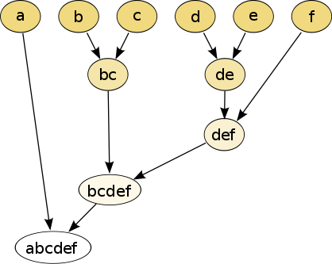
HIERARCHICAL CLUSTERING
Hierarchical clustering is a method of cluster analysis which
seeks to build a hierarchy of clusters.
Strategies for hierarchical clustering generally fall into two types
Agglomerative:
This is a "bottom up" approach: each observation starts in its
own cluster, and pairs of clusters are merged as one moves
up the hierarchy.
Divisive:
This is a "top down" approach: all observations
start in one cluster, and splits are performed recursively
as one moves down the hierarchy.
Agglomerative clustering
Notes:
https://en.wikipedia.org/wiki/Hierarchical_clustering

Slide 17
AGGLOMERATIVE Algorithm
The following algorithm is an agglomerative scheme that erases rows and columns in a proximity matrix as old clusters are merged into new ones.
The algorithm is composed of the following steps:
Begin with the disjoint clustering having level L(0) = 0 and sequence number m = 0.s
Find the most similar pair of clusters in the current clustering, say pair (r), (s), according to d[(r),(s)] = min d[(i),(j)] where the minimum is over all pairs of clusters in the current clustering.
Increment the sequence number: m = m + 1. Merge clusters (r) and (s) into a single cluster to form the next clustering m. Set the level of this clustering to L(m) = d[(r),(s)]
Update the proximity matrix, D, by deleting the rows and columns corresponding to clusters (r) and (s) and adding a row and column corresponding to the newly formed cluster. The proximity between the new cluster, denoted ( r, s) and old cluster (k) is defined as d[(k), (r , s)] = min d[(k),(r)], d[(k),(s)].
If all objects are in one cluster, stop. Else, go to step 2.

Slide 18
ADVANTAGES and DISAVANATGES
Advantages
Hierarchical Clustering can give diﬀerent partitioning's depending on the level-of-resolution we are looking at
It doesn’t need the number of clusters to be speciﬁed
Disadvantages
High in time complexity
No actual objective function

Slide 19
Conditional Random Field
This model is also referred to as a generative model.
The term p(y_{i}∣y_{i−1}) reflects the Markov property that the probability of a future state y_{i}, depends only on current state y_{i−1}(given past states)
while the term p(x_{i} ∣y_{i}) can be viewed as a likelihood, or observation on x_{i}. In order to be computationally tractable, they assume that each data is generated independently by a hidden process.
Suppose:
P(Voter lives in state B|Voter supports liberal candidate) =
P(Voter supports liberal candidate|Voter lives in state B)P(Voter lives in state B)/
(P(Voter supports lib. cand.|Voter lives in state A)P(Voter lives in state A) + P(Voter supports lib. cand.|Voter lives in state B)P(Voter lives in state B) + P(Voter supports lib. cand.|Voter lives in state C)P(Voter lives in state C))
= (0.60)*(0.25)/((0.50)*(0.40) + (0.60)*(0.25) + (0.35)*(0.35)) = (0.15)/(0.20 + 0.15 + 0.1225) = 0.15/0.4725 = 0.3175.
Notes:
https://en.wikipedia.org/wiki/Conditional_random_field

Slide 20

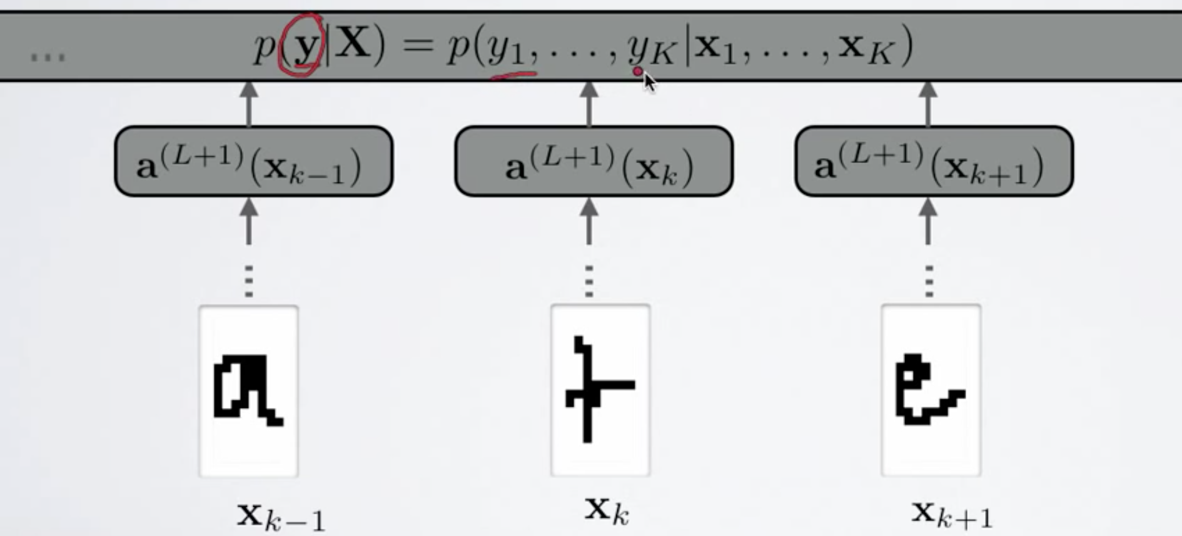

ALGORITHM
1. Transform each τ -time-point time series into a τ −1 dimensional feature vector.
2. Assign a random label to each time series to form an initial label configuration.
3. For each time series i
3.1 Form a voting pool, Ni.
3.2 Calculate the cost functions of the labels of the members in the voting pool.
3.3 Calculate the probabilities of the labels based on their cost functions.
3.4 Assign the label with the greatest probability yj to time series i if its current label yi is not equal to yj.
4. Go back to Step 3 if the label of any time series is updated, otherwise stop

Slide 21
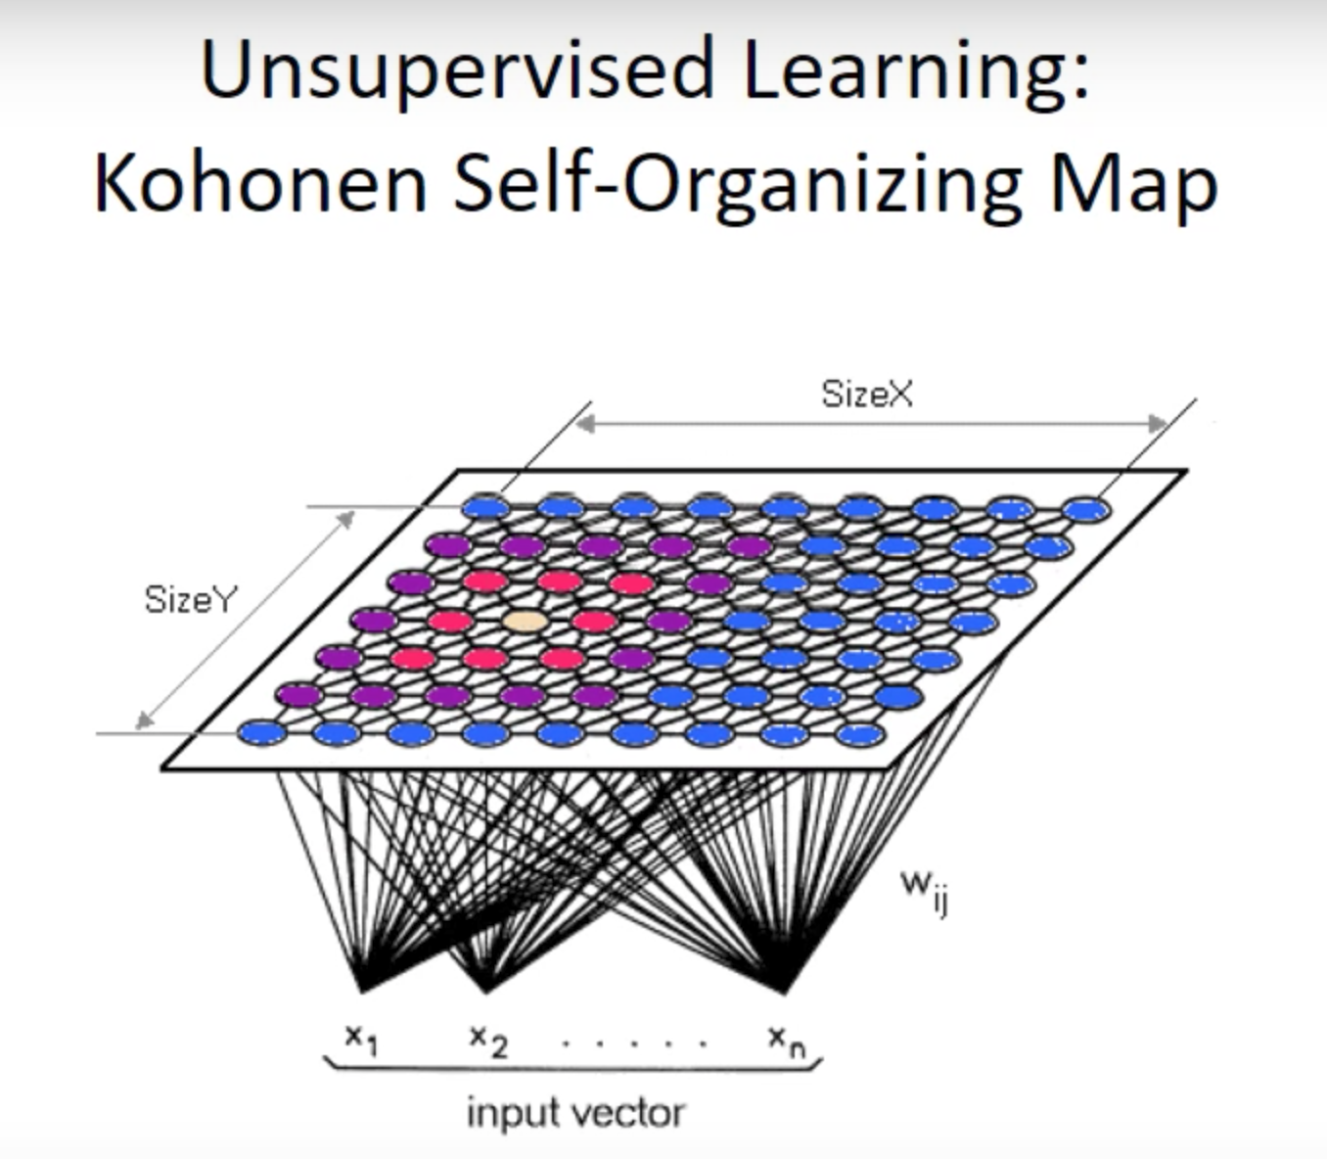
Self ORGANISING MAP
SOM is a type of artificial neural network (ANN) that is trained using unsupervised learning to produce a low-dimensional(two-dimensional),discretized representation of map.
It operate in two modes: training and mapping:
Training builds the map using input examples
Mapping classifies the new input vector
SOM uses neighborhood distance to preserve topology of map and also aligning winner neuron towards the input data
Notes:
https://en.wikipedia.org/wiki/Self-organizing_map
https://www.youtube.com/watch?v=GdZckTLNqsY
https://www.youtube.com/watch?v=H9H6s-x-0YE

Slide 22
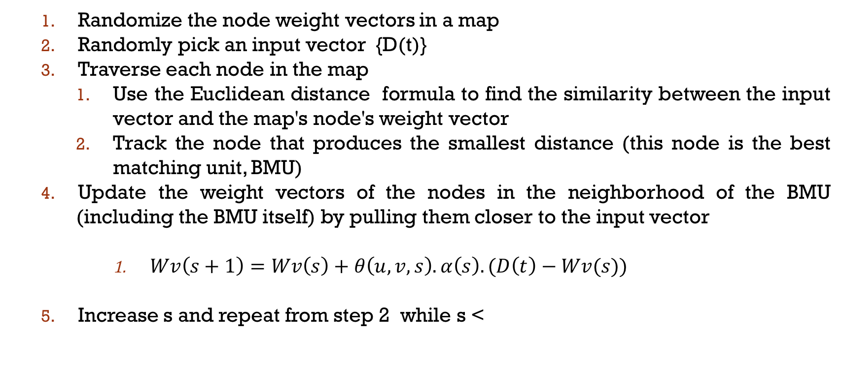

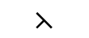
Algorithm
Randomize the node weight vectors in a map
Randomly pick an input vector {D(t)}
Traverse each node in the map
Use the Euclidean distance formula to find the similarity between the input vector and the map's node's weight vector
Track the node that produces the smallest distance (this node is the best matching unit, BMU)
Update the weight vectors of the nodes in the neighborhood of the BMU (including the BMU itself) by pulling them closer to the input vector
$Wv\left(s+1\right)=Wv\left(s\right)+θ\left(u,v,s\right).α\left(s\right).(D\left(t\right)−Wv(s))$
Increase s and repeat from step 2 while s <
$$⋋$$

Slide 23
ADVANTAGES and DISADVANTAGES
Advantages
Self organized Model
Responding to every input stimulus
Helpful in reducing dimensions of input data
Disadvantages
1D (proven) topological ordering property does not extend to 2D
slow training, hard to train against slowly evolving data
not so intuitive : neurons close on the map (topological proximity) may be far away in feature space
no generally admitted rule of thumb for the various parameters (map size, neighboring function, time evolution of the learning rate ...)

Slide 24
References
https://en.wikipedia.org/wiki/Category:Cluster_analysis_algorithms
http://scikit-learn.org/stable/modules/clustering.html

Slide 25
THANK YOU….!

